Slide 1


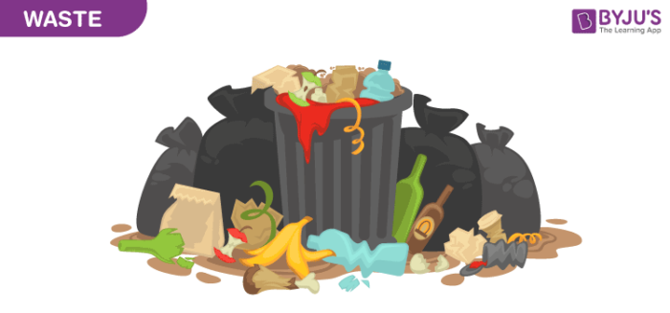
School of Basic and Applied Science
Course Code : Course Name: Wsate Management
Introduction to E-Waste, Biomedical waste and Solid waste.
Name of the Faculty: Dr. Diwakar Chauhan Program Name: BSc (Hons.)

Slide 2
School of Basic and Applied Science
Course Code : MEV303 Course Name: Techniques in Environmental Sciences
Introduction about Waste
What are Wastes?
Wastes (also known as rubbish, trash, refuse, garbage, junk, litter) is unwanted or useless materials. In biology, waste is any unwanted substances or toxins that are expelled from living organisms and metabolic waste such as urea and sweat.
Waste is generated from human activity mostly. Rapid and unplanned development and modification of livelihood all over the world put complexity in the generated waste. Overall biosphere is degraded rapidly due to continuous release of hazardous pollutants from different industries throughout the world. Rapid expansion of health-care facilities and modernization of agricultural practices generate large quantity of biomedical and agricultural wastes which brings adverse effect on environmental health. There are three kinds of wastes mainly such as solid waste, liquid waste and gaseous waste.
Name of the Faculty: Dr. Divya Tripathy Program Name: M.Sc Environmental Science Sem III

Slide 3
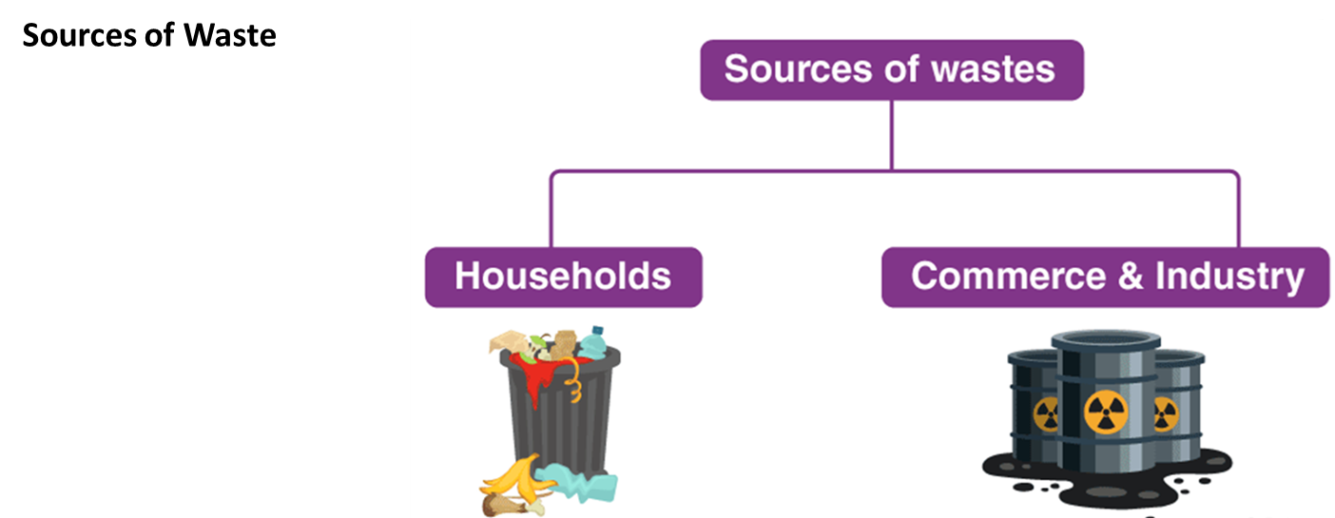
School of Basic and Applied Science
Course Code : MEV303 Course Name: Techniques in Environmental Sciences
Waste is defined as unwanted and unusable materials and is regarded as a substance which is of no use. Waste that we see in our surroundings is also known as garbage. Garbage is mainly considered as a solid waste that includes wastes from our houses (domestic waste), wastes from schools, offices, etc. (municipal wastes) and wastes from industries and factories (industrial wastes).
Name of the Faculty: Dr. Divya Tripathy Program Name: M.Sc Environmental Science Sem III

Slide 4
School of Basic and Applied Science
Course Code : MEV303 Course Name: Techniques in Environmental Sciences
Classification of Waste
Waste can be solid, liquid and gas or waste heat. Waste is classified by its source and by its characteristics. Waste products can be differentiated according to their source and types.
Generally there are four sources from where waste can be generated such as industrial, municipal, biomedical and electronic. Waste can be classified on the basis of different criteria such as based on matter, based on degradation feature, based on environmental impact and based on the source. Each category may be of different types which are shown on Fig. 1.
Name of the Faculty: Dr. Divya Tripathy Program Name: M.Sc Environmental Science Sem III

Slide 5
School of Basic and Applied Science
Course Code : MEV303 Course Name: Techniques in Environmental Sciences
Name of the Faculty: Dr. Divya Tripathy Program Name: M.Sc Environmental Science Sem III

Slide 6
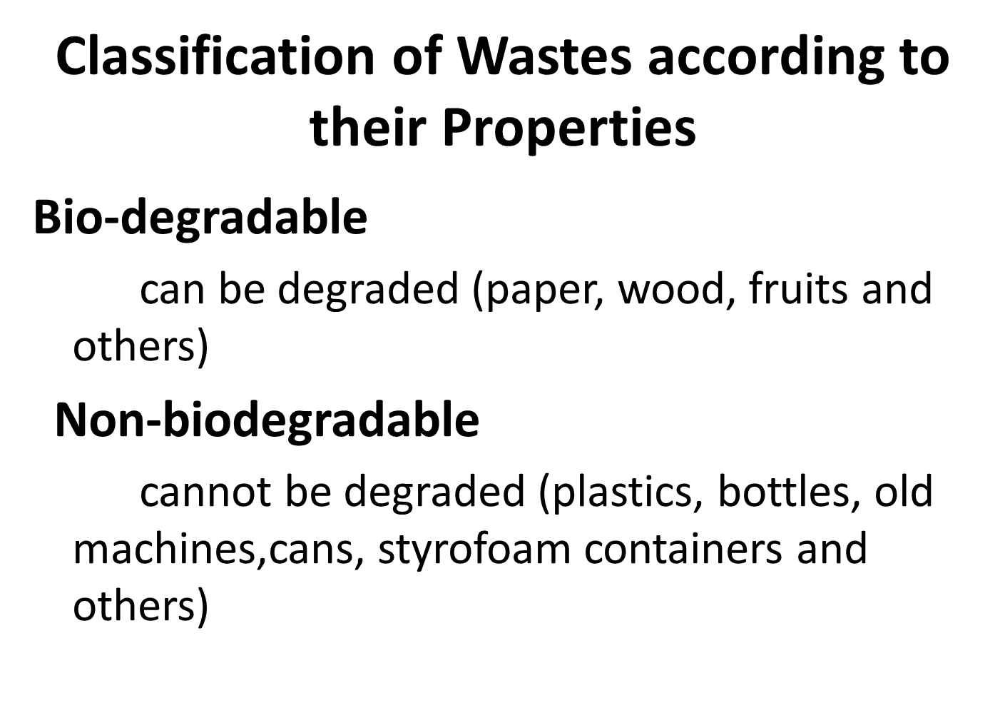
School of Basic and Applied Science
Course Code : MEV303 Course Name: Techniques in Environmental Sciences
Name of the Faculty: Dr. Divya Tripathy Program Name: M.Sc Environmental Science Sem III

Slide 7
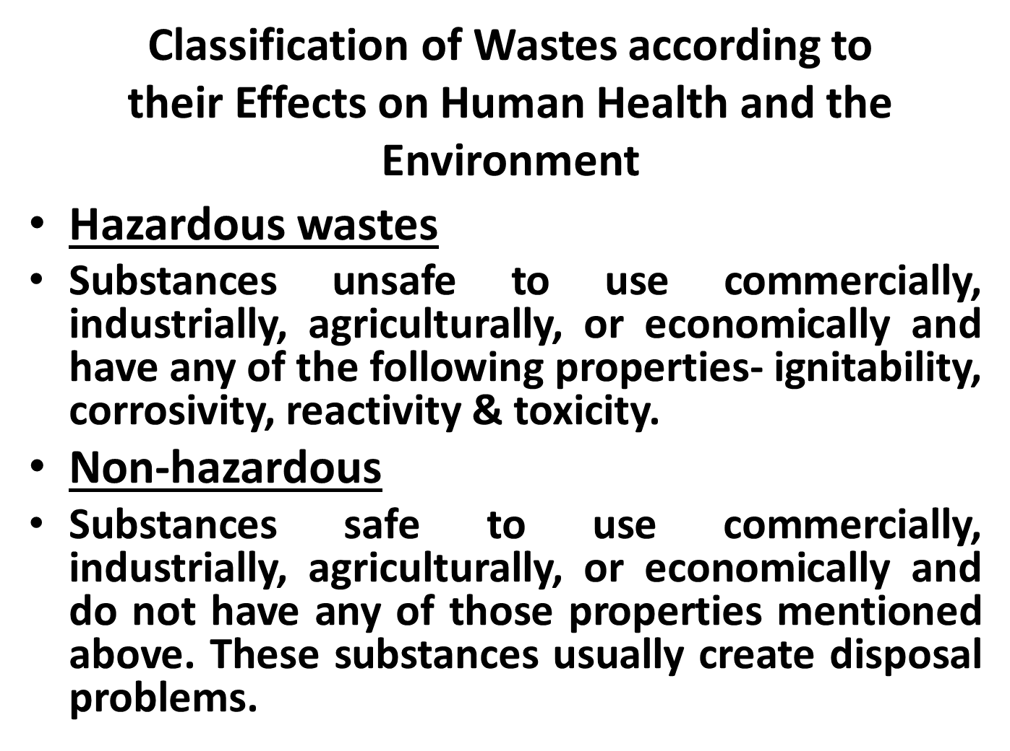
School of Basic and Applied Science
Course Code : MEV303 Course Name: Techniques in Environmental Sciences
Name of the Faculty: Dr. Divya Tripathy Program Name: M.Sc Environmental Science Sem III

Slide 8
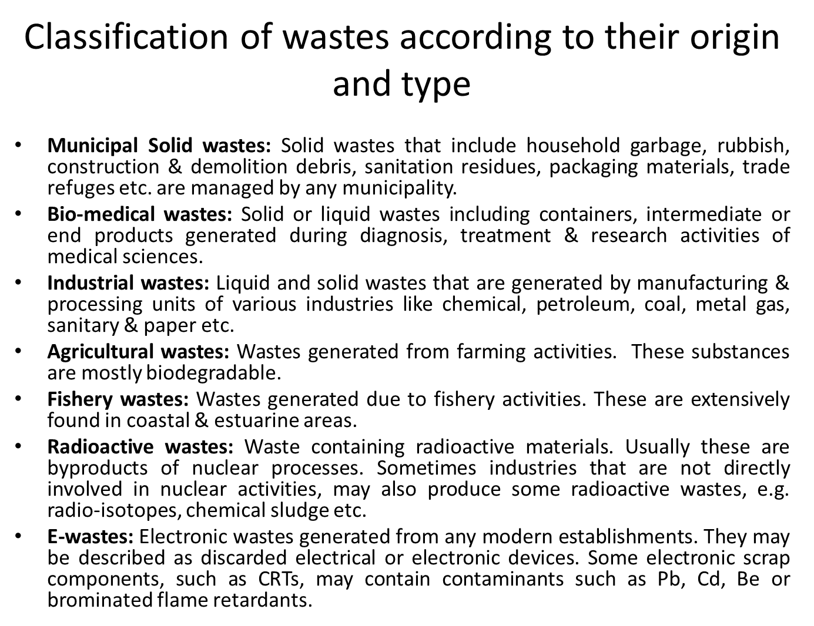
School of Basic and Applied Science
Course Code : MEV303 Course Name: Techniques in Environmental Sciences
Name of the Faculty: Dr. Divya Tripathy Program Name: M.Sc Environmental Science Sem III

Slide 9
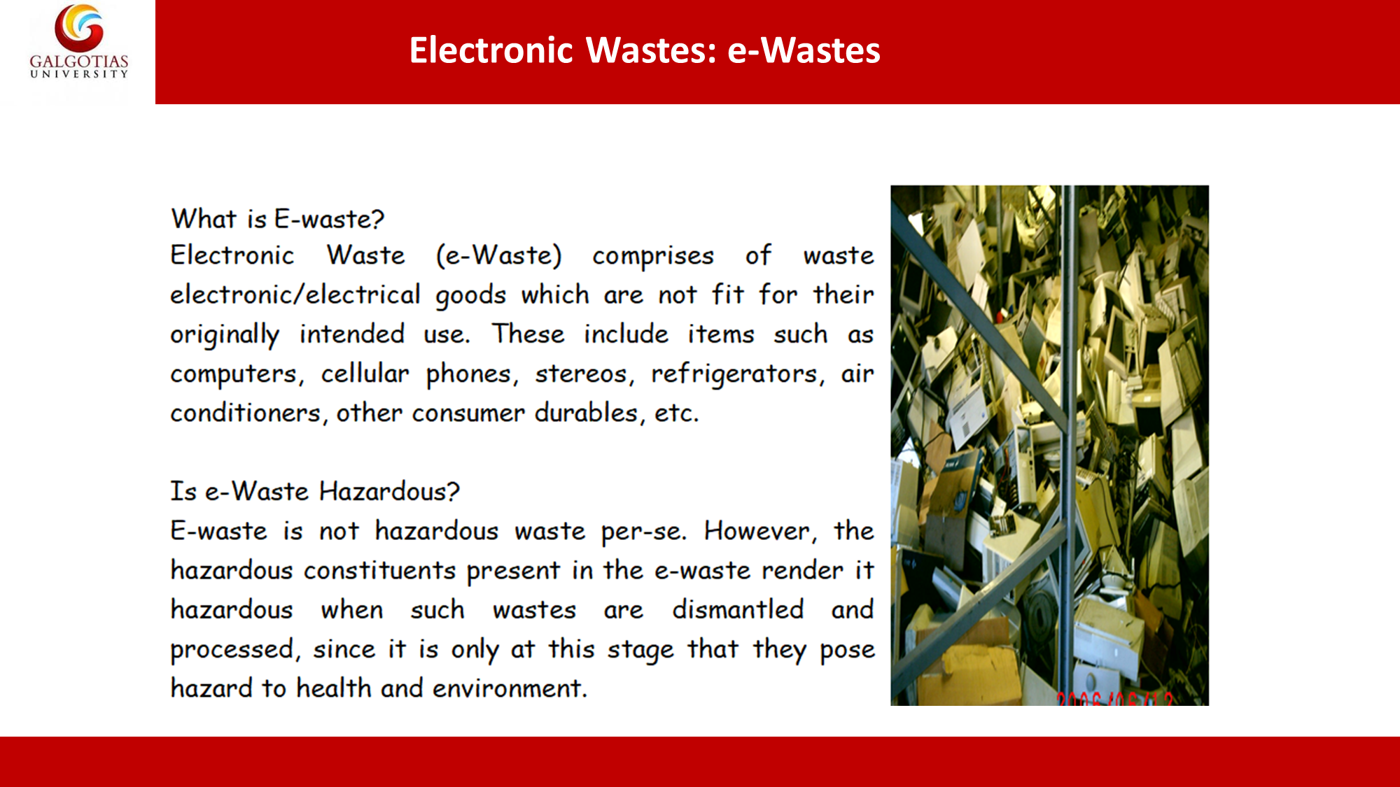
School of Basic and Applied Science
Course Code : MEV303 Course Name: Techniques in Environmental Sciences
Name of the Faculty: Dr. Divya Tripathy Program Name: M.Sc Environmental Science Sem III

Slide 10
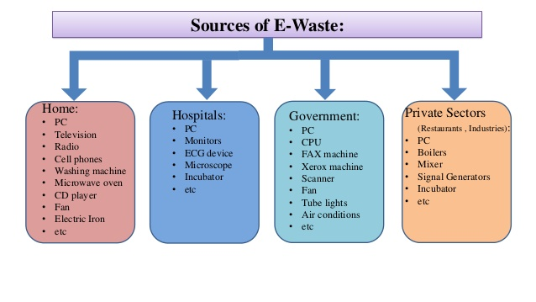
School of Basic and Applied Science
Course Code : MEV303 Course Name: Techniques in Environmental Sciences
Name of the Faculty: Dr. Divya Tripathy Program Name: M.Sc Environmental Science Sem III

Slide 11
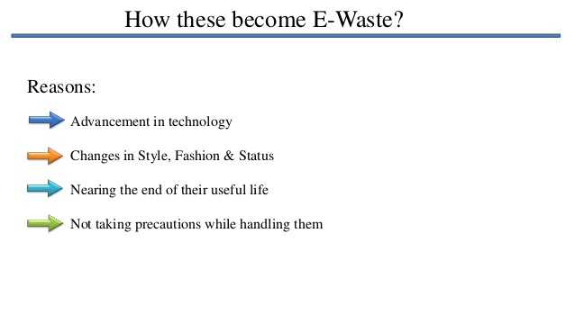
School of Basic and Applied Science
Course Code : MEV303 Course Name: Techniques in Environmental Sciences
Name of the Faculty: Dr. Divya Tripathy Program Name: M.Sc Environmental Science Sem III

Slide 12
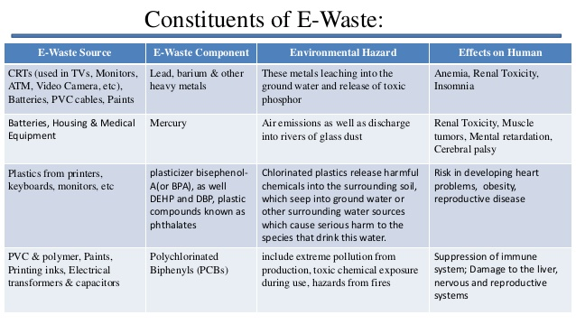
School of Basic and Applied Science
Course Code : MEV303 Course Name: Techniques in Environmental Sciences
Name of the Faculty: Dr. Divya Tripathy Program Name: M.Sc Environmental Science Sem III

Slide 13
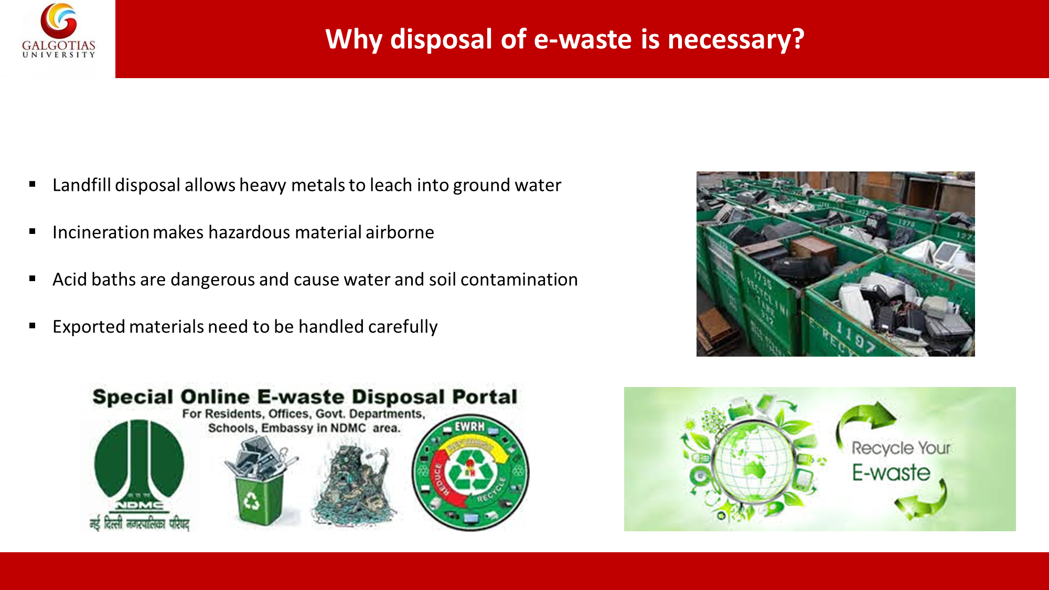
School of Basic and Applied Science
Course Code : MEV303 Course Name: Techniques in Environmental Sciences
Name of the Faculty: Dr. Divya Tripathy Program Name: M.Sc Environmental Science Sem III

Slide 14
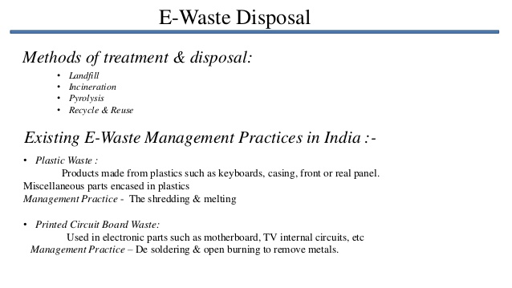
School of Basic and Applied Science
Course Code : MEV303 Course Name: Techniques in Environmental Sciences
Name of the Faculty: Dr. Divya Tripathy Program Name: M.Sc Environmental Science Sem III

Slide 15
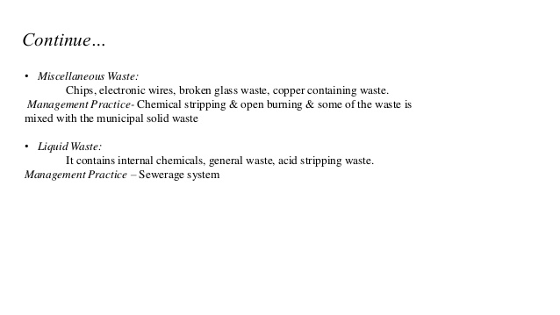
School of Basic and Applied Science
Course Code : MEV303 Course Name: Techniques in Environmental Sciences
Name of the Faculty: Dr. Divya Tripathy Program Name: M.Sc Environmental Science Sem III

Slide 16
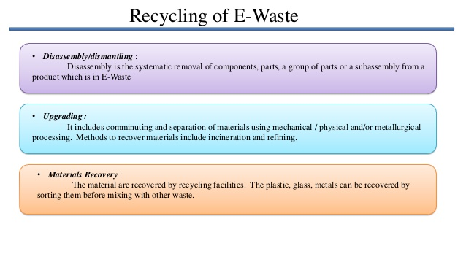
School of Basic and Applied Science
Course Code : MEV303 Course Name: Techniques in Environmental Sciences
Name of the Faculty: Dr. Divya Tripathy Program Name: M.Sc Environmental Science Sem III

Slide 17
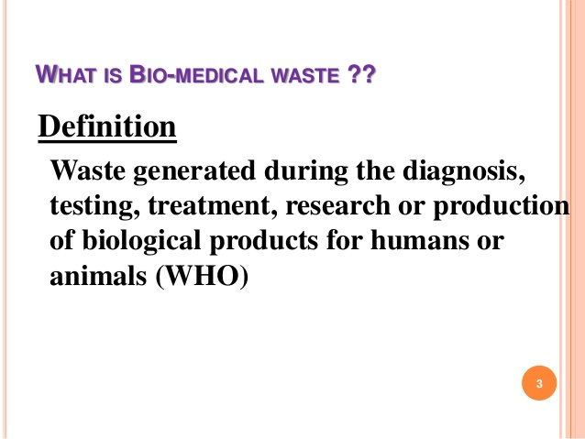
School of Basic and Applied Science
Course Code : MEV303 Course Name: Techniques in Environmental Sciences
Name of the Faculty: Dr. Divya Tripathy Program Name: M.Sc Environmental Science Sem III

Slide 18
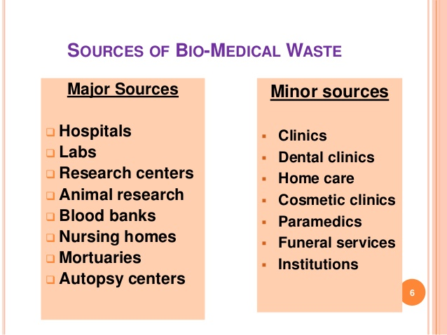
School of Basic and Applied Science
Course Code : MEV303 Course Name: Techniques in Environmental Sciences
Name of the Faculty: Dr. Divya Tripathy Program Name: M.Sc Environmental Science Sem III

Slide 19
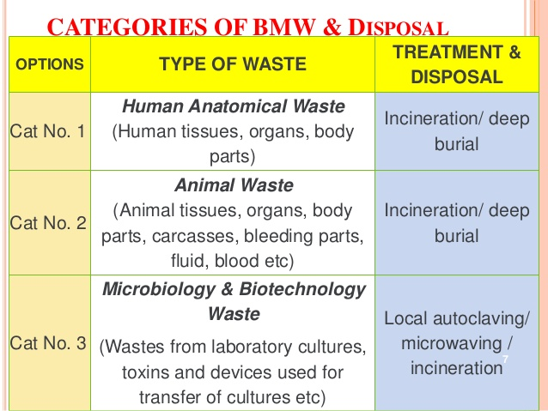
School of Basic and Applied Science
Course Code : MEV303 Course Name: Techniques in Environmental Sciences
Name of the Faculty: Dr. Divya Tripathy Program Name: M.Sc Environmental Science Sem III

Slide 20
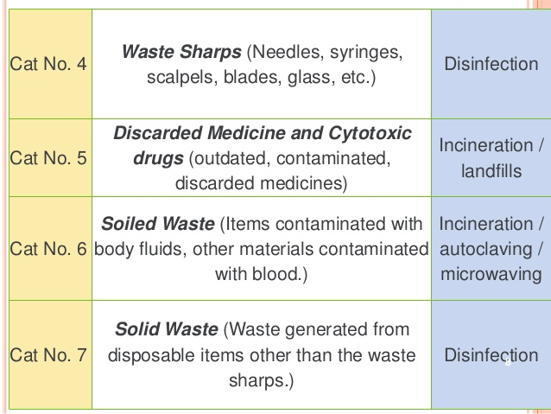
School of Basic and Applied Science
Course Code : MEV303 Course Name: Techniques in Environmental Sciences
Name of the Faculty: Dr. Divya Tripathy Program Name: M.Sc Environmental Science Sem III

Slide 21
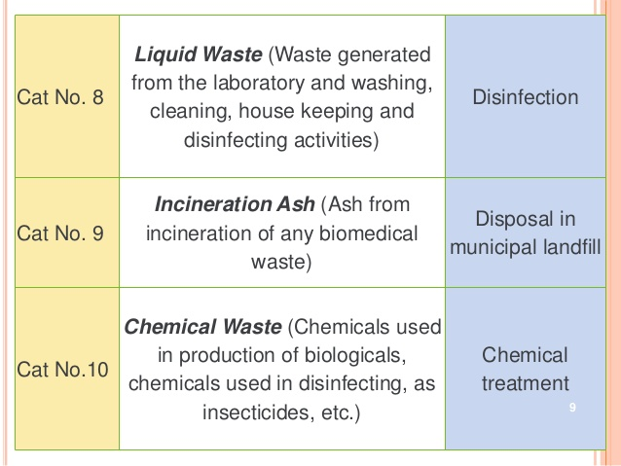
School of Basic and Applied Science
Course Code : MEV303 Course Name: Techniques in Environmental Sciences
Name of the Faculty: Dr. Divya Tripathy Program Name: M.Sc Environmental Science Sem III

Slide 22
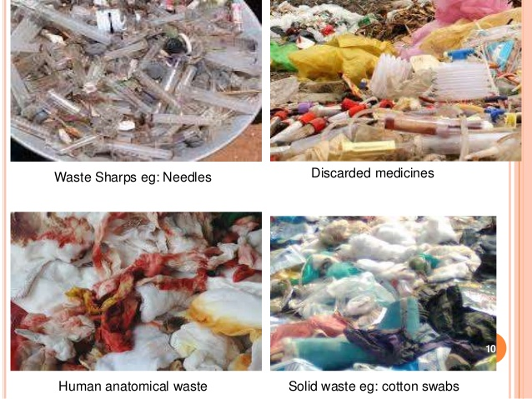
School of Basic and Applied Science
Course Code : MEV303 Course Name: Techniques in Environmental Sciences
Name of the Faculty: Dr. Divya Tripathy Program Name: M.Sc Environmental Science Sem III

Slide 23
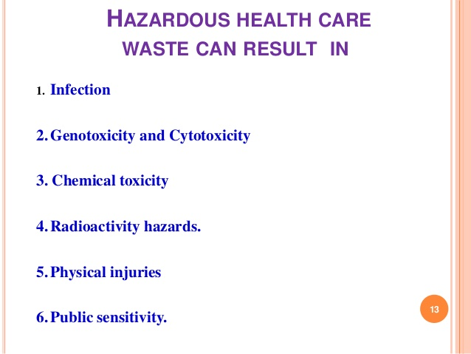
School of Basic and Applied Science
Course Code : MEV303 Course Name: Techniques in Environmental Sciences
Name of the Faculty: Dr. Divya Tripathy Program Name: M.Sc Environmental Science Sem III

Slide 24
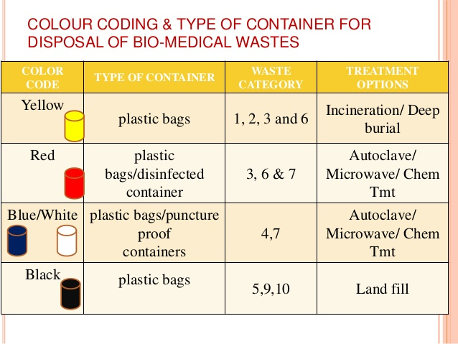
School of Basic and Applied Science
Course Code : MEV303 Course Name: Techniques in Environmental Sciences
Name of the Faculty: Dr. Divya Tripathy Program Name: M.Sc Environmental Science Sem III

Slide 25
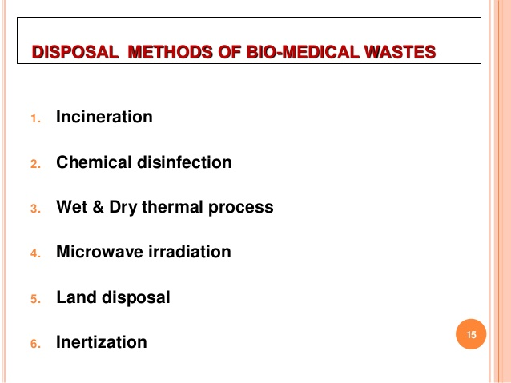
School of Basic and Applied Science
Course Code : MEV303 Course Name: Techniques in Environmental Sciences
Name of the Faculty: Dr. Divya Tripathy Program Name: M.Sc Environmental Science Sem III

Slide 26
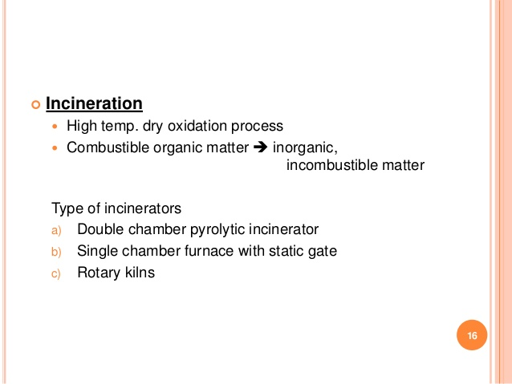
School of Basic and Applied Science
Course Code : MEV303 Course Name: Techniques in Environmental Sciences
Name of the Faculty: Dr. Divya Tripathy Program Name: M.Sc Environmental Science Sem III

Slide 27
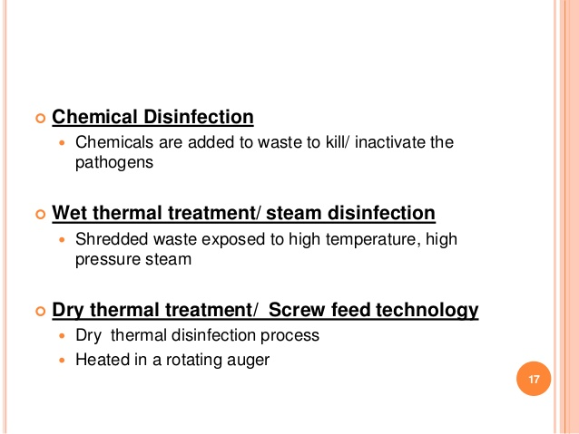
School of Basic and Applied Science
Course Code : MEV303 Course Name: Techniques in Environmental Sciences
Name of the Faculty: Dr. Divya Tripathy Program Name: M.Sc Environmental Science Sem III

Slide 28
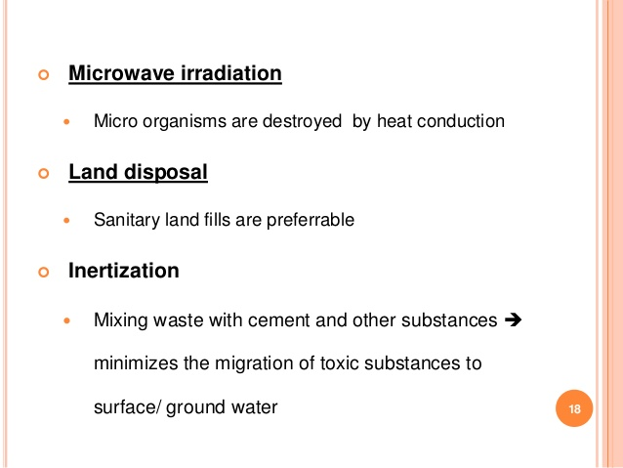
School of Basic and Applied Science
Course Code : MEV303 Course Name: Techniques in Environmental Sciences
Name of the Faculty: Dr. Divya Tripathy Program Name: M.Sc Environmental Science Sem III

Slide 29
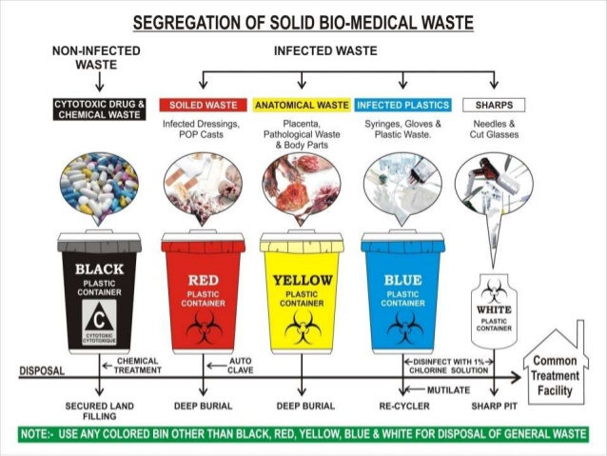
School of Basic and Applied Science
Course Code : MEV303 Course Name: Techniques in Environmental Sciences
Name of the Faculty: Dr. Divya Tripathy Program Name: M.Sc Environmental Science Sem III

Slide 30
School of Basic and Applied Science
Course Code : MEV303 Course Name: Techniques in Environmental Sciences
Name of the Faculty: Dr. Divya Tripathy Program Name: M.Sc Environmental Science Sem III

Slide 31
School of Basic and Applied Science
Course Code : MEV303 Course Name: Techniques in Environmental Sciences
Solid Waste
What is Solid Waste?
Solid waste comprises of all the wastes arising from human and animal activities that are typically solid and that are discarded as useless or unwanted.
Some of the commonly used synonyms in solid wastes are:
Re-use: This is a more appropriate term for solid waste as most waste can be utilized as a raw material for some other purpose.
Garbage: It consist of kitchen/wet waste.
Rubbish: Those wastes with high ash content.
Scrap: Wastes that have high metal content.
Debris: Bulky wastes such as construction waste.
Name of the Faculty: Dr. Divya Tripathy Program Name: M.Sc Environmental Science Sem III

Slide 32
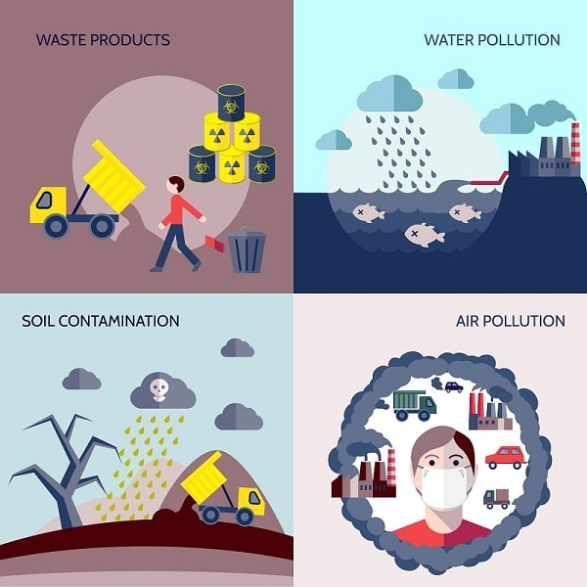
School of Basic and Applied Science
Course Code : MEV303 Course Name: Techniques in Environmental Sciences
Impacts Of Solid Wastes
Chemical poisoning through chemical inhalation
Uncollected waste can obstruct the storm water runoff resulting in flood
Soil Contamination
Cancer
Neurological disease
Nausea and vomiting
Increase in hospitalization of residents living near hazard waste sites.
Mercury toxicity from eating fish with high levels of mercury.
Name of the Faculty: Dr. Divya Tripathy Program Name: M.Sc Environmental Science Sem III

Slide 33
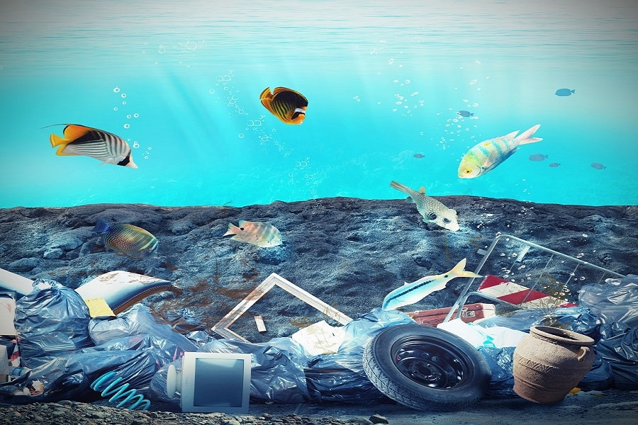
School of Basic and Applied Science
Course Code : MEV303 Course Name: Techniques in Environmental Sciences
Impacts Of Solid Wastes On Aqualtic Life
-
-
Increase in mercury level in fish due to disposal of mercury in the rivers.
Plastic found in oceans ingested by birds.
Resulted in high algal population in rivers and sea.
Degrades water and soil quality.
Change in climate and destruction of ozone layer due to waste biodegradable- Green house gas -Methane
Leaching: is a process by which solid waste enter soil and ground water and contaminating them.
Name of the Faculty: Dr. Divya Tripathy Program Name: M.Sc Environmental Science Sem III

Slide 34
School of Basic and Applied Science
Course Code : MEV303 Course Name: Techniques in Environmental Sciences
Solid waste Reduction
-
-
WHAT SHOULD BE DONE ??
Reduce Waste
Improve product design to use less materials.
- Redesign packaging to eliminate excess toxic materials while maintaining the quality.
- Work with customers to design and implement a packaging.
- Switch to reusable transport containers.
- Purchase products in bulk.
Reuse
Reuse office furniture and supplies, such as envelopes, file folders, and paper.
- Use durable towels, tablecloths, napkins, dishes, cups, and glasses.
- Use reusable packaging materials for outgoing shipments.
- Encourage employees to reuse office materials rather than purchase new ones.
Name of the Faculty: Dr. Divya Tripathy Program Name: M.Sc Environmental Science Sem III

Slide 35
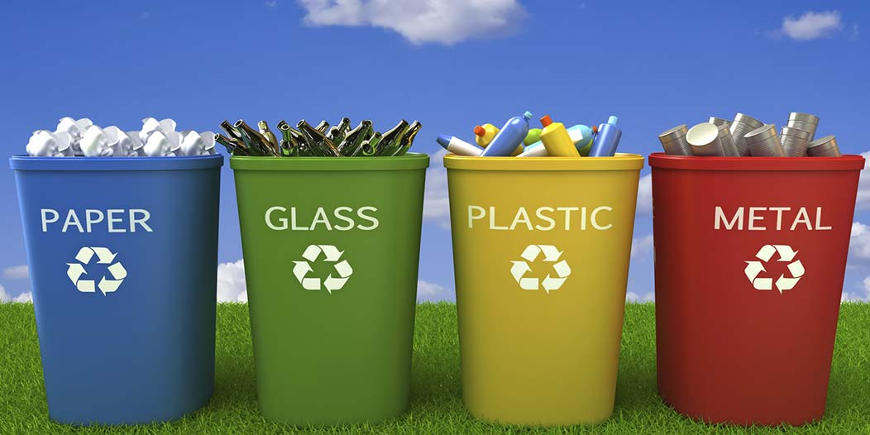
School of Basic and Applied Science
Course Code : MEV303 Course Name: Techniques in Environmental Sciences
Solid waste Reduction
Conduct outreach program adopting an ecologically sound waste management system which includes:
waste reduction
segregation at source
Composting
recycling and re-use
more efficient collection
more environmentally sound disposal
Name of the Faculty: Dr. Divya Tripathy Program Name: M.Sc Environmental Science Sem III
\

Slide 36
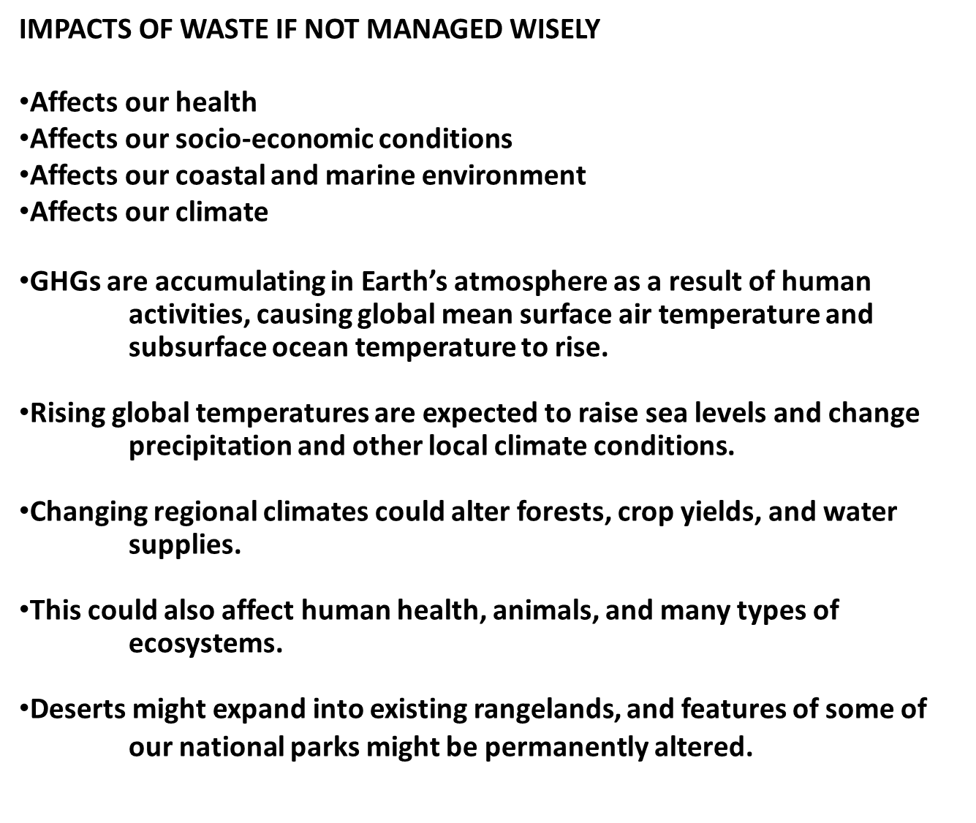
School of Basic and Applied Science
Course Code : MEV303 Course Name: Techniques in Environmental Sciences
Name of the Faculty: Dr. Divya Tripathy Program Name: M.Sc Environmental Science Sem III

Slide 37
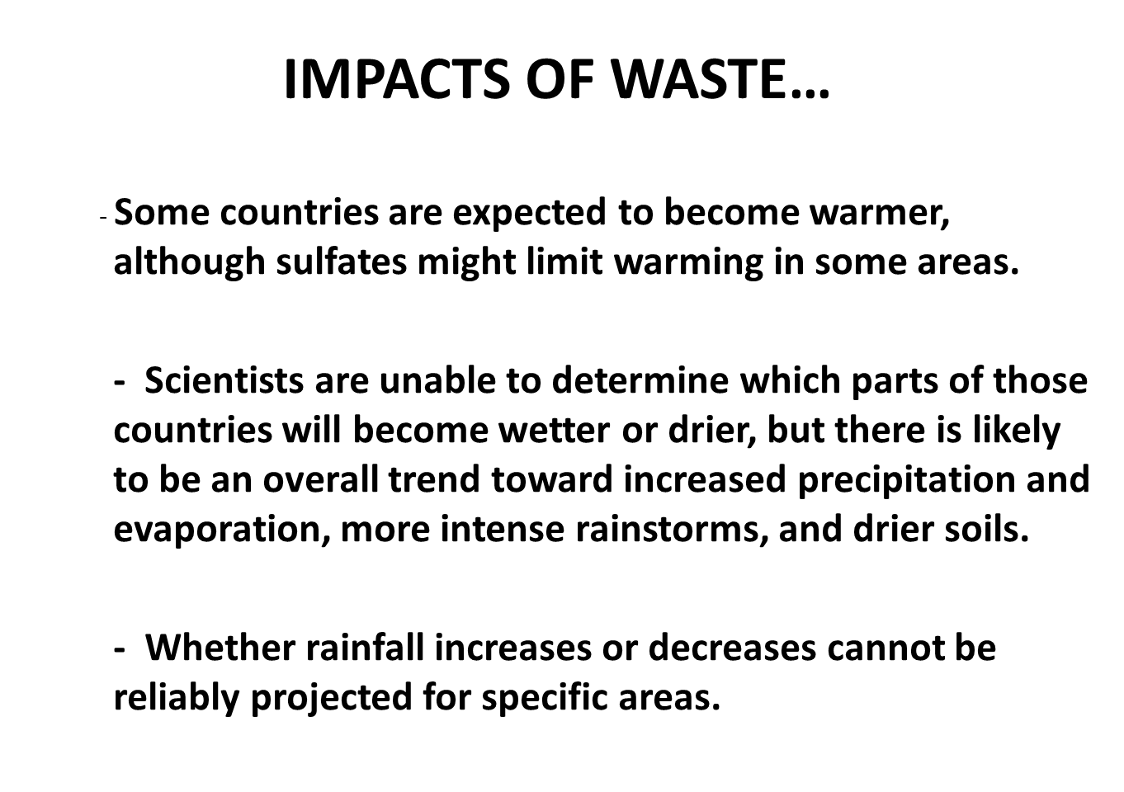
School of Basic and Applied Science
Course Code : MEV303 Course Name: Techniques in Environmental Sciences
Name of the Faculty: Dr. Divya Tripathy Program Name: M.Sc Environmental Science Sem III

Slide 38
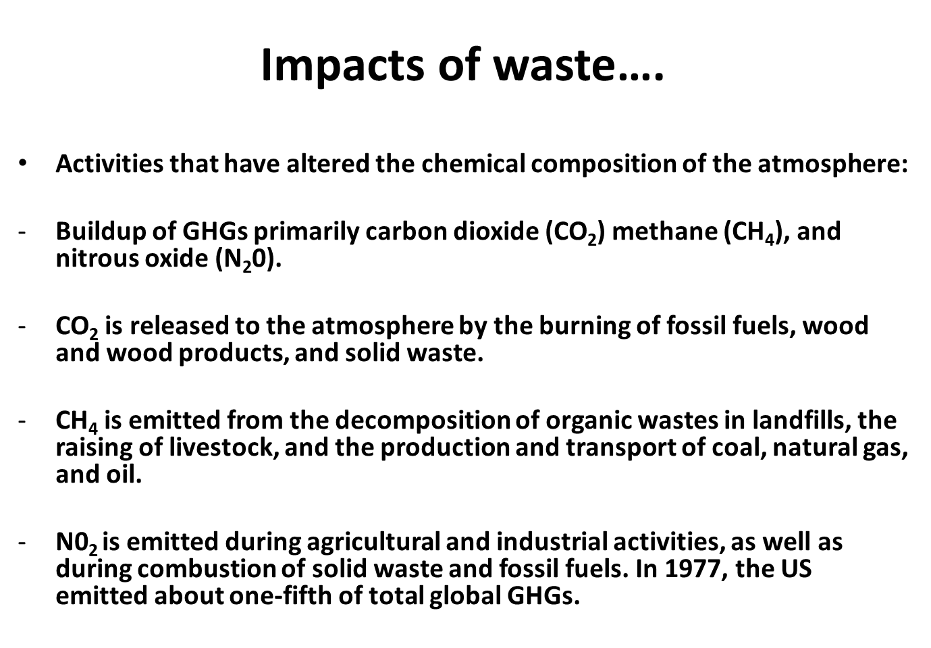
School of Basic and Applied Science
Course Code : MEV303 Course Name: Techniques in Environmental Sciences
Name of the Faculty: Dr. Divya Tripathy Program Name: M.Sc Environmental Science Sem III

Slide 39
School of Basic and Applied Science
Course Code : MEV303 Course Name: Techniques in Environmental Sciences
References
1. Environmental Studies , Benny Joseph , Tata McGraw Hill Education Private Limited, 2009, ISBN: 987-0-07-064813-5.
2. Environmental Studies, Ranu Gadi, Sunitta Rattan, Sushmita Mohapatra, S.K. Kataria and Sons , 2008, ISBN: 81-89757-98-9.
3. Environmental Studies, Anindita Basak, Pearson Education, 2009, ISBN: 978-81-317-2118-6.
4. Principles of Environmental Science (Inquiry and Applications), William P. Cunningham & Mary Ann Cunningham, Tata McGraw Hill Education Private Limited,2007, ISBN: 987-0-07-064772-0.
IMAGES
5. https://www.metropolitantransferstation.com.au/blog/negative-effects-of-improper-waste-management
6. https://www.metropolitantransferstation.com.au/blog/negative-effects-of-improper-waste-management
VIDEO SOURCES
7. https://www.youtube.com/watch?v=jtiANpcpJJY
8. https://www.youtube.com/watch?v=oONzyciDp5s
Name of the Faculty: Dr. Divya Tripathy Program Name: M.Sc Environmental Science Sem III

Slide 40
School of Basic and Applied Science
Course Code : MEV303 Course Name: Techniques in Environmental Sciences
THANK YOU
Name of the Faculty: Dr. Divya Tripathy Program Name: M.Sc Environmental Science Sem III

